Slide 1
Hospice 101: Medicare Eligibility Criteria

Slide 2
Objectives
By the end of this presentation, participants will be able to:
Identify who determines the rules for hospice eligibility
Describe the criteria for the most common hospice diagnoses
Describe the components of an assessment for eligibility
Describe the Open Access model for hospice care

Slide 3

Experience
Has anyone here worked for a hospice?
Do you know anyone personally who has received hospice care?
What do you think of when you consider hospice?
Would you refer someone to hospice?
If not, why not?
When would you refer a patient to hospice?

Slide 4
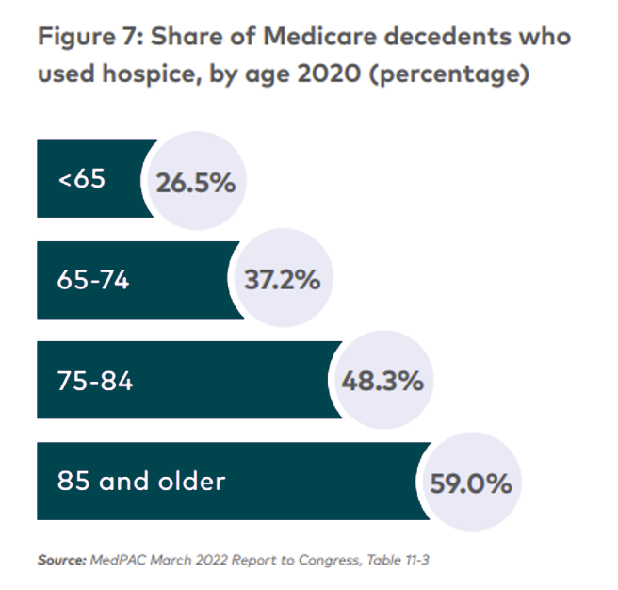
Hospice is not just for old people
Notes:
Patient Age
Is not a criteria for hospice care. Medicare part A does fully cover hospice care for medicare eligible individuals.

Slide 5
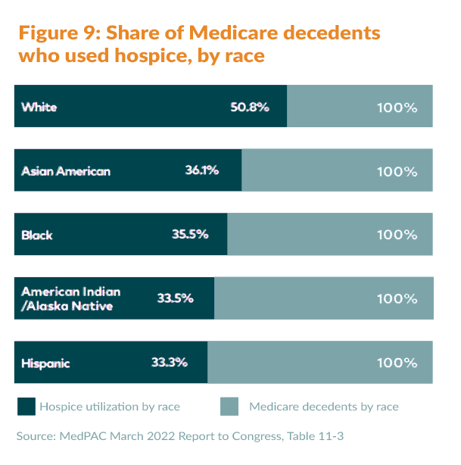
Hospice is open to all
Why might members of some cultures be less likely to choose hospice?

Slide 6
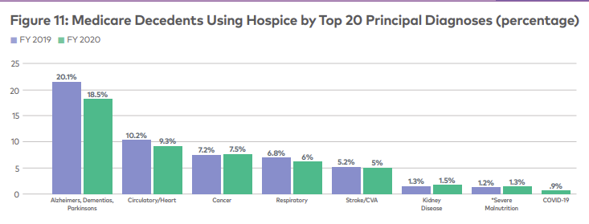
What diagnoses are most often referred?
Notes:
Principal Diagnosis
The principal hospice diagnosis is the diagnosis that has been determined to be the most contributory to the patient’s terminal prognosis. Specific diagnoses have been collapsed into major disease groupings. 2019 showed that more Medicare hospice patients had a principal diagnosis of Alzheimer’s/Dementia/Parkinson’s than any other disease.

Slide 7
What are the eligibility criteria?

Slide 8

Who qualifies for hospice?
ANYONE with a terminal illness when two physicians certify an expectation of 6 months or less to live
Accept Palliative Care
Most hospice patients are covered under Medicare part A
Most insurance policies include hospice coverage
Many Medicaid policies include hospice coverage
Haven will bill on a sliding scale for patients with no health care coverage
Medicare Condition of participation: Interdisciplinary group, care planning, and coordination of services. § 418.56

Slide 9
Eligibility determination
Disease specific criteria based on
Details of disease progression
Functional assessments
Co-morbidities
Conditions that contribute to decline
Labs and other diagnostic tests
Decision not to pursue a cure
Notes:
Interactive with audience … they contribute examples

Slide 10

Medicare administrative contractors (MAC)
Medicare contracts locally with companies that provide guidelines and oversight for area hospices
They provide criteria for the most common admitting diagnoses

Slide 11
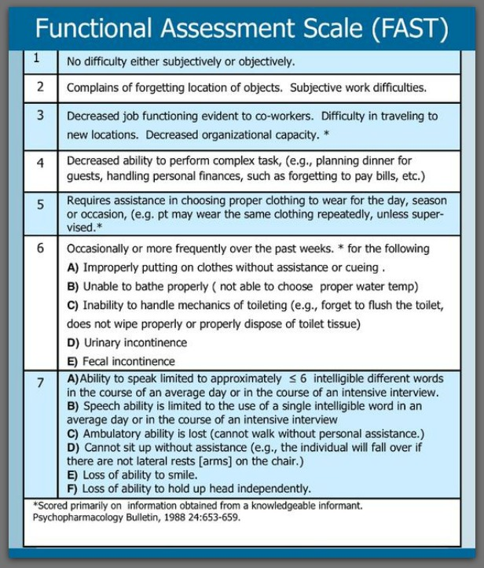
FAST Scores for Alzheimer’s Assessment
Medicare requires a FAST score of 7A-F for a hospice eligible determination
NOTE: Patients with Alzheimer's Disease with a higher score may be admitted for a different qualifying diagnosis

Slide 12
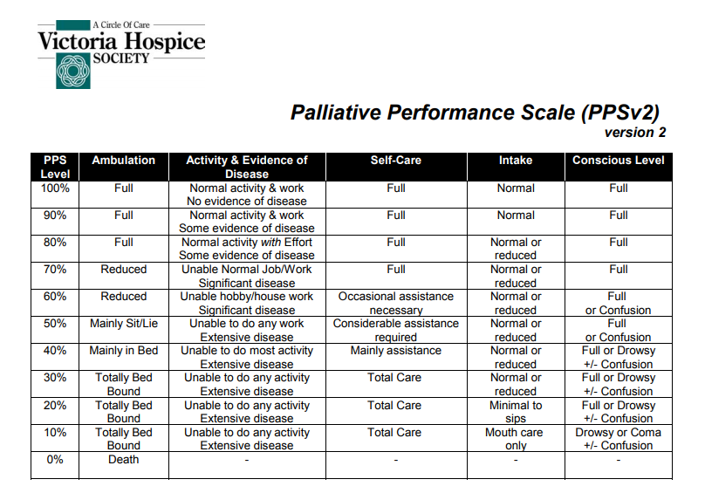
Palliative Performance Scale
PPS scores are an important part of determining eligibility for all diagnoses except cancer
PPS of 40% or lower is considered eligible

Slide 13
Activities of Daily Living assessments provide evidence of declining independence
Activities of Daily Living
ADL | Description
Bathing | The ability to clean oneself and perform grooming activities like shaving and brushing teeth.
Dressing | The ability to get dressed by oneself without struggling with buttons and zippers
Eating | The ability to feed oneself
Transferring | Being able to either walk or move oneself from a bed to a wheelchair and back again
Toileting | The ability to get on and off the toilet
Continence | The ability to control one's bladder and bowel functions
https://www.elderlawanswers.com/activities-of-daily-living-measure-the-need-for-long-term-care-assistance-15395

Slide 14

Alzheimer’s/ Dementia
FAST score stage 7A
PLUS
Co-morbid or secondary conditions contributing to decline (i.e. frequent falls, dysphagia, weight loss, COPD, Parkinson’s, etc.).
PPS = 40% or less.

Slide 15

FAST scoring – Functional Assessment Staging Test
All patients with a primary diagnosis or co-morbidity diagnosis of Alzheimer’s disease must have a FAST score at admission and every nursing visit
Patients with a FAST of 6 or 7 must have the number and sub-stage (letter) included
To be eligible for hospice services with a primary diagnosis of Alzheimers Disease the score must be at least 7 and the sub-stage listed (ie 7A, 7C, etc.)
FAST scores never improve, never have a range and don’t skip!
FAST score is ONLY used for patients with Alzheimer’s as a primary or a comorbid diagnosis

Slide 16

The Picture of Late Alzheimer’s Disease
Very severe cognitive decline. All verbal abilities are lost
Frequently there is no speech at all - only grunting
Incontinent of urine
Require assistance toileting and feeding
Lose basic psychomotor skills, e.g., ability to walk, sitting and head control
The brain appears to no longer be able to tell the body what to do
Generalized and cortical neurologic signs and symptoms are frequently present
Stages of Alzheimer’s 2023 Alzheimer’s Association. https://www.alz.org/alzheimers-dementia/stages

Slide 17

Palmetto LCD: Cardiopulmonary
Specific functional impairments, (dyspnea at rest, O2 dependent, maximum medications, ongoing symptoms such as chest pain, dyspnea or edema)
Include co-morbidities and secondary conditions contributing to decline
PPS = 40% or less

Slide 18

Palmetto LCD: HIV/AIDS
Must have both CD4 count < 25 and persistent viral load >100,000
PLUS one of the following:
CNS lymphoma, wasting (loss of 33% lean body mass not responsive to treatment); Myobacterium avium complex; progressive multifocal leukoencephalopathy; systemic lymphoma; visceral Kaposi’s sarcoma; renal failure (no dialysis); Cryptosporidium infection; Toxoplasmosis unresponsive to treatment
PPS 40% or less
Co-morbidities contributing to decline (i.e. hepatitis C)
This Photo by Unknown Author is licensed under CC BY-NC

Slide 19

Haven LCD: Cancer
Stage IV, metastatic, advanced, progressive disease; non-curable
May be receiving palliative RT or chemo
Chart must have documentation that includes evidence of progressive, non-curable disease (i.e. pathology reports, CT/PET scans, oncology notes, etc.)
PPS may be above 40% as patients with metastatic disease decline rapidly

Slide 20
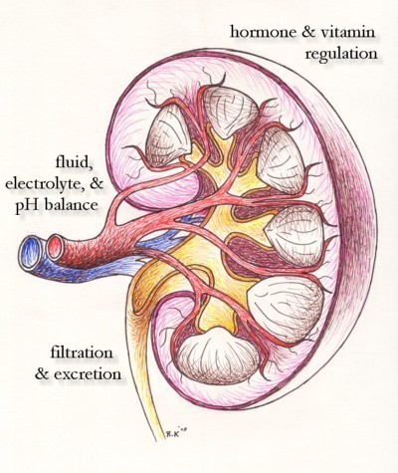
Palmetto LCD: Renal Disease
Specific functional impairments, i.e.
Dyspnea
Edema
Weakness
Falls
Include any co-morbidities and secondary conditions contributing to decline, i.e. heart disease, refusing dialysis, electrolyte imbalance, etc. PPS = 40% or less.

Slide 21
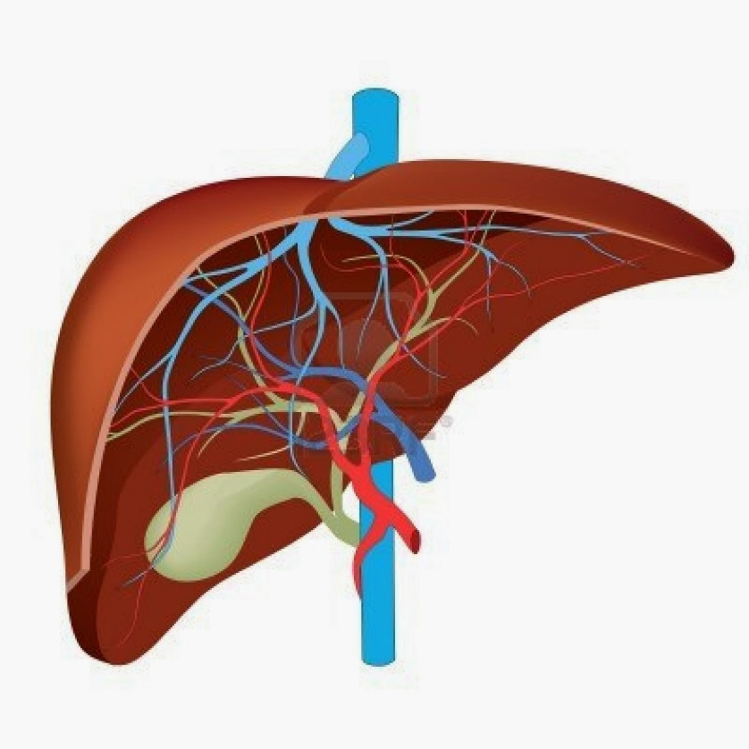
Haven LCD: Liver Disease
Must have both 1 and 2
Prothrombin time > 5 seconds over control or INR > 1.5 AND serum albumin < 2.5
At least one of the following: refractory ascites: pt non-compliance; bacterial peritonitis; hepatorenal syndrome; hepatic encephalopathy; recurrent variceal bleeding
Co-morbidities and secondary conditions: progressing malnutrition, muscle wasting, continued active alcoholism; hepatocellular carcinoma; Hep B; Hep C refractory to treatment

Slide 22
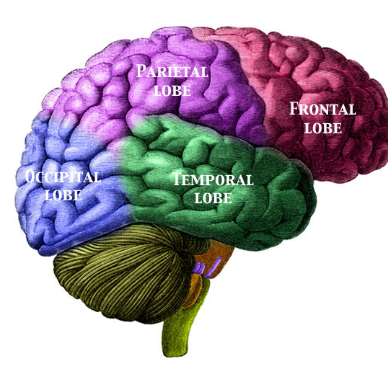
Palmetto LCD: Neurological Conditions
Specific functional impairments, i.e.
Dysphagia
Non-ambulatory
Dependent in most ADLs
PPS = 40% or less
Include co-morbidities and secondary conditions contributing to decline, i.e. falls, recurrent UTIs, wounds, etc.

Slide 23
Supporting documentation/information needed for eligibility determination
Referral diagnosis
Medical records
History from patient and family- change in weight, symptom history, activity tolerance and ability to manage self care
Measurable data: weight/weight loss; diagnostic test results

Slide 24
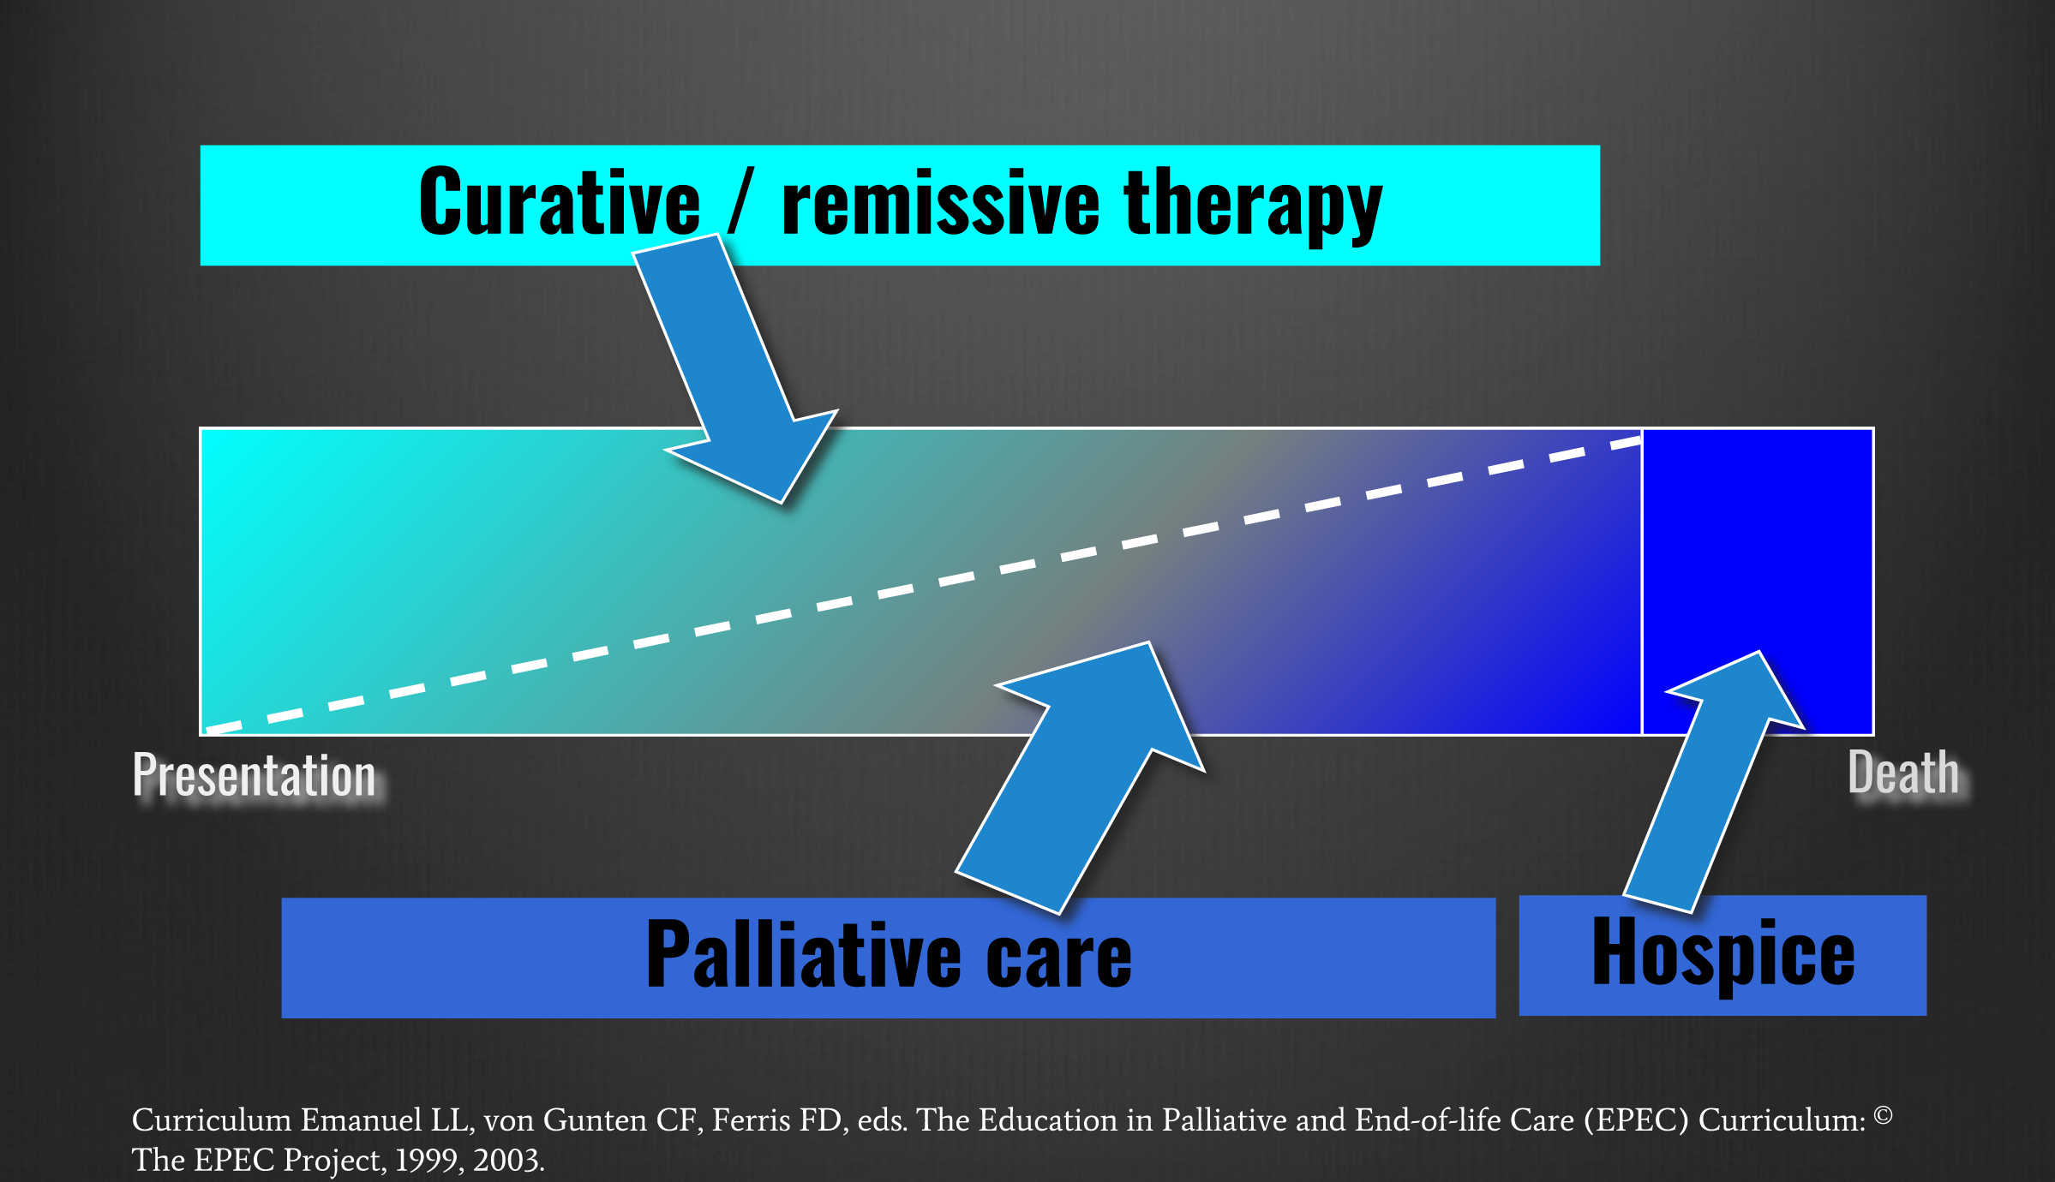
Aggressive care does not disqualify
Aggressive vs. curative

Slide 25

Haven uses the Open Access model
Eligibility is not determined by cost of care
If a patient is eligible for hospice – we will offer admission
Any treatment may be acceptable if it does not change hospice eligibility

Slide 26
Open Access
Definition: All patients meeting eligibility are offered admission
Palliative treatments can be in the hospice plan of care
Chemotherapy | Pre-Transplant | Mental Health/Psychiatric Disease
Radiation Therapy | Bariatrics | Dialysis
Intravenous and Oral Antibiotics | Pediatrics | Total Parenteral Nutrition
Physical/Occup/Massage Therapy* | Ventilator/BiPAP | Intravenous Inotropes
Wound Care | Transfusion | Paracentesis/Thoracentesis
We must disclose in advance when a treatment is non-palliative and is not aligned with the treatment plan

Slide 27
When is it time to consider hospice care?
Would you be surprised if the patient were still alive in 6 months?
Is the patient showing a steady decline in health?
Frequent hospitalizations
Progressive weight loss
Increased weakness, fatigue, somnolence
Poor performance status
Declining cognitive status
Poor nutritional status
Pressure ulcers
Comorbidities
Do they have a specific diagnosis contributing to the decline?
Has the patient expressed a desire to stop treatment/hospitalizations?
https://www.americannursetoday.com/refer-patients-hospice-care/

Slide 28
Palliative Care
Chronic or progressive illness, but seeking curative treatment
Assists with advance care planning WHILE receiving curative treatment
Care is provided in conjunction with primary physician or specialists
Medical equipment such as hospital bed, oxygen, wheelchair, etc. can be ordered by the provider
Nurse practitioner provides in home visits to support the patient’s goals of care

Slide 29
Resources
Electronic Code of Federal Regulations: Title 42-Chapter IV- Subchapter B- Part 418 – Subpart B 418.20 downloaded 9/13/2023
https://www.ecfr.gov/current/title-42/part-418
Accreditation Commission for Health Care (ACHC) Standards; Hospice Care Services. 4/4/2023 Section 2: Program/Service Operations: Standard HSP2-1A; 42CFR 418.20 Eligibility requirements.
National Hospice and Palliative care Organization Compliance Guide. Medicare Hospice Certification and recertification compliance guide, April 2016.
Stages of Alzheimer’s 2023 Alzheimer’s Association.
https://www.alz.org/alzheimers-dementia/stages

